Slide 1
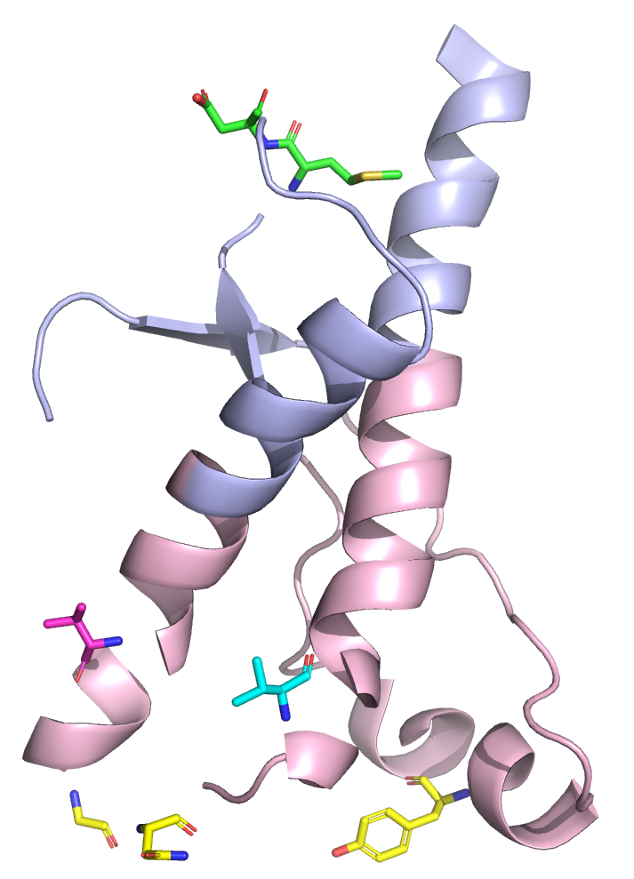
Computational analysis of human prion protein’s allosteric potential reveals potential pharmacological chaperone binding site for V189I and V203I PrP^{Sc}
Reagan McNeill Womack
Dr. Joshua Ring, advisor
Department of Chemistry, Lenoir-Rhyne University
Notes:
Hello, my name is Reagan Womack and I’m a chemistry major here at lenoir-rhyne
Now, that’s a long title, so let me simplify it a bit

Slide 2
Identifying Drug Binding Sites on Human Prion Protein
Reagan McNeill Womack
Dr. Joshua Ring, advisor
Department of Chemistry, Lenoir-Rhyne University
Notes:
My research focused on using computer models and simulations to identify potential drug binding sites on human prion protein
These sites could be targeted by drug molecules to prevent the progression of prion diseases… but what are prion diseases?

Slide 3
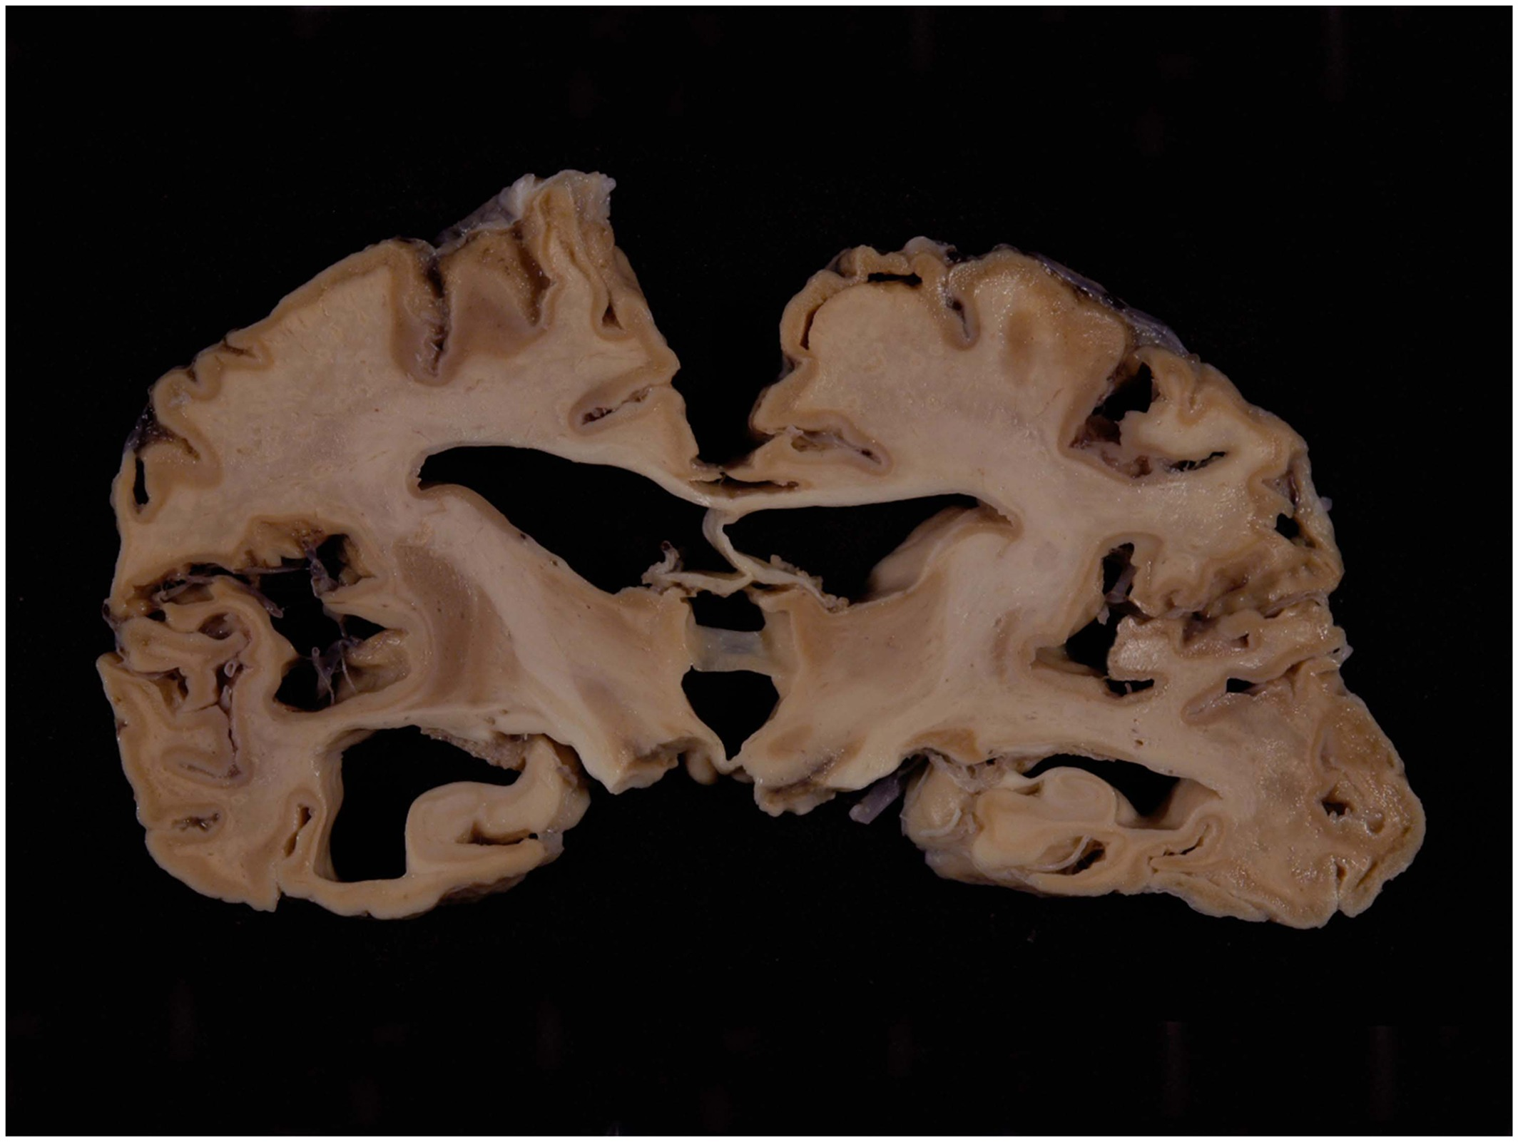
Prion Diseases
Mad Cow Disease (Bovine Spongiform Encephalopathy)
Scrapie
Chronic Wasting Disease
Creutzfeldt-Jakob Disease
Iwasaki, Y. (2017). Creutzfeldt‐Jakob disease. Neuropathology, 37(2), 174-188. https://doi.org/10.1111/neup.12355
Notes:
Prion diseases are a class of neurodegenerative diseases characterized by rapid and fatal disease progression
More common prion diseases: Mad cow, scrapie, chronic wasting disease
In humans: Creutzfeldt-Jakob disease

Slide 4
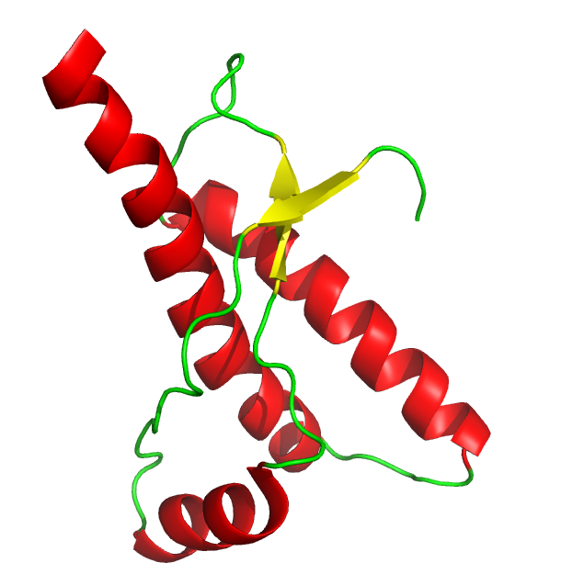
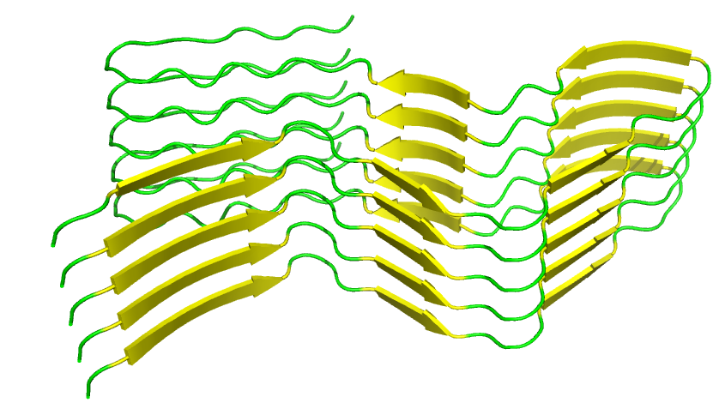
Misfolded Prion Protein Forms Amyloid Fibrils
Notes:
Normal structure of prion protein consists of 3 alpha helices and 2 small beta sheets
When there is a mutation on PRNP gene encoding prion protein, structure might prefer to fold into beta-sheet rich conformation instead of normal conformation

Slide 5
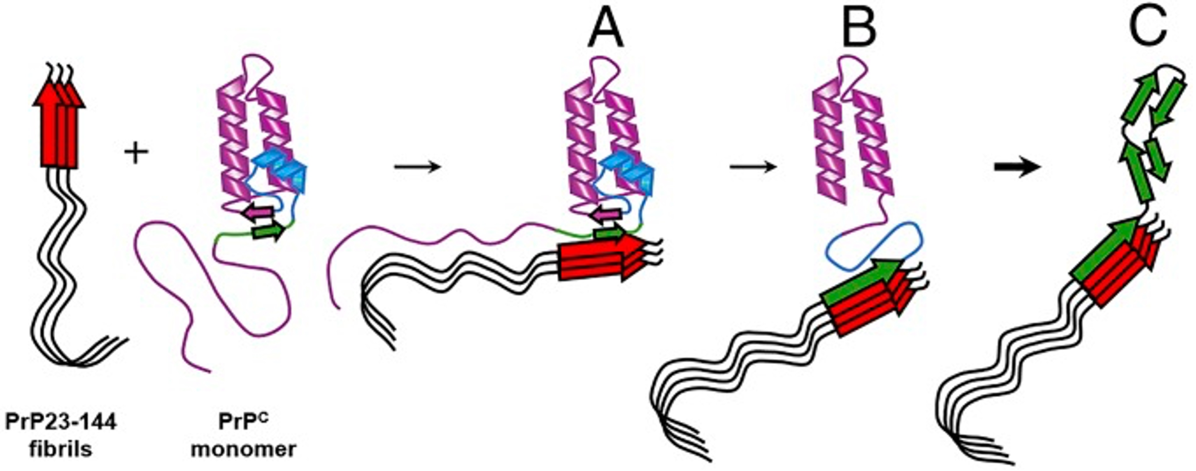
Prions are Infectious
Choi, J., Cali, I., Surewicz, K., Kong, Q., Gambetti, P., & Surewicz, W. K. (2016). Amyloid fibrils from the N-terminal prion protein fragment are infectious. Proceedings of the National Academy of Sciences - PNAS, 113(48), 13851-13856. https://doi.org/10.1073/pnas.1610716113
Notes:
Current working theory for how prion diseases progress
Abnormal prion attaches to normal prion protein and adds it to growing amyloid fibril
Amyloid fibrils very rigid and hard to break up, making early intervention crucial

Slide 6
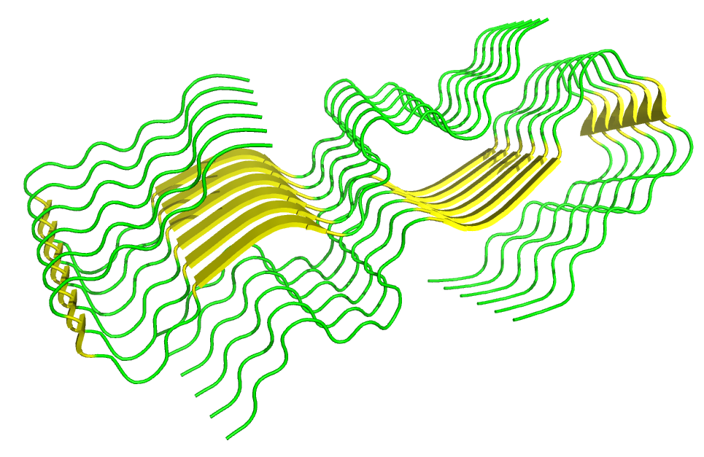
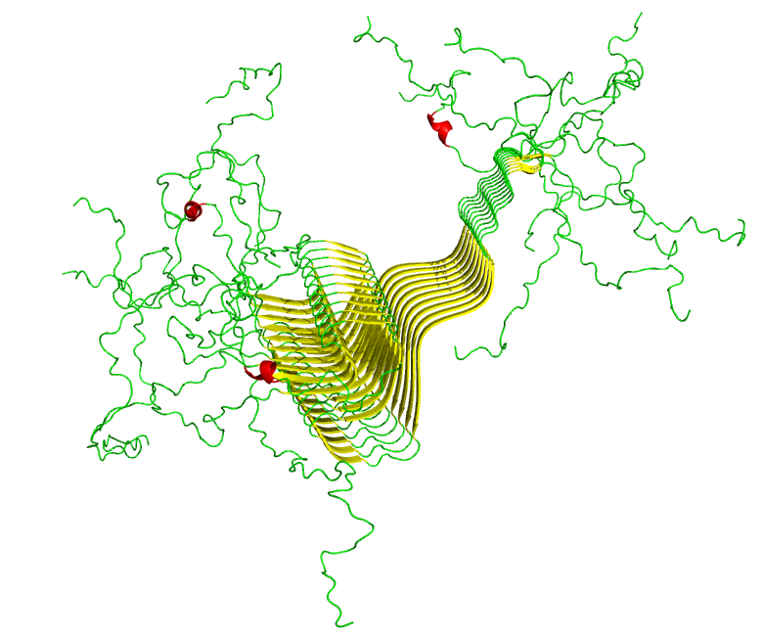
Other Diseases Show Prion-like Pathogenesis
Alzheimer’s Disease (amyloid-β peptide)
Parkinson’s Disease (α-synuclein)
Notes:
Prion diseases aren’t the only diseases that are caused by these growing amyloid fibrils
Alzheimer’s & amyloid-beta peptide
Parkinson’s & alpha-synuclein

Slide 7
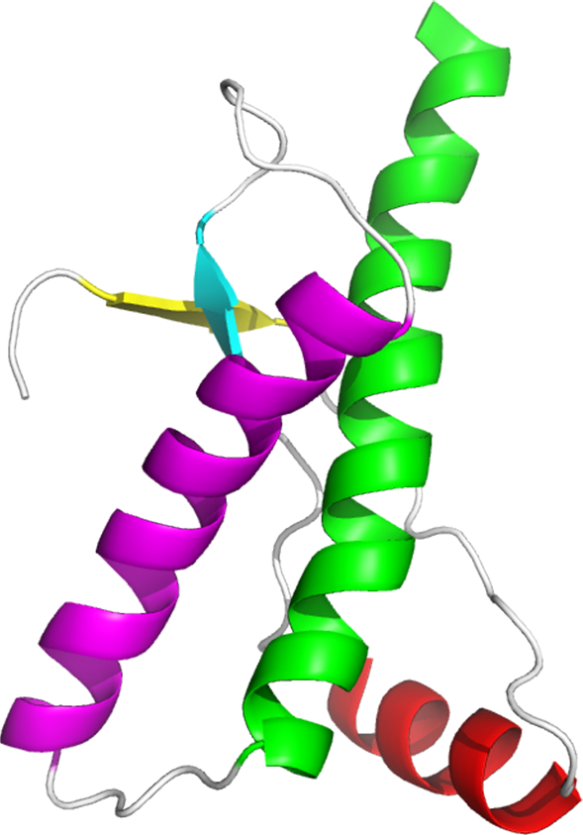
The Structure Of PrP^{C} Provides Insight Into Regulation
Non-conserved α2-α3 loop is proposed to be the site at which misfolding begins
Notes:
If we look back at structure of normal prion protein, we can find some information that may guide our search for a drug binding site
Alpha2-alpha3 loop area where misfolding starts, then spreads to rest of protein

Slide 8
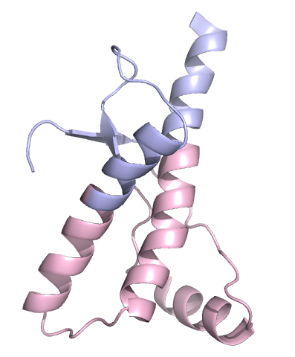
The Structure Of PrP^{C} Provides Insight Into Regulation
PrP^{C} can be divided into 2 subdomains, separated by disulfide bridge connecting α2 and α3
Notes:
Prion protein can also be divided into 2 subdomains
Lower subdomain where many infectious mutations are located

Slide 9
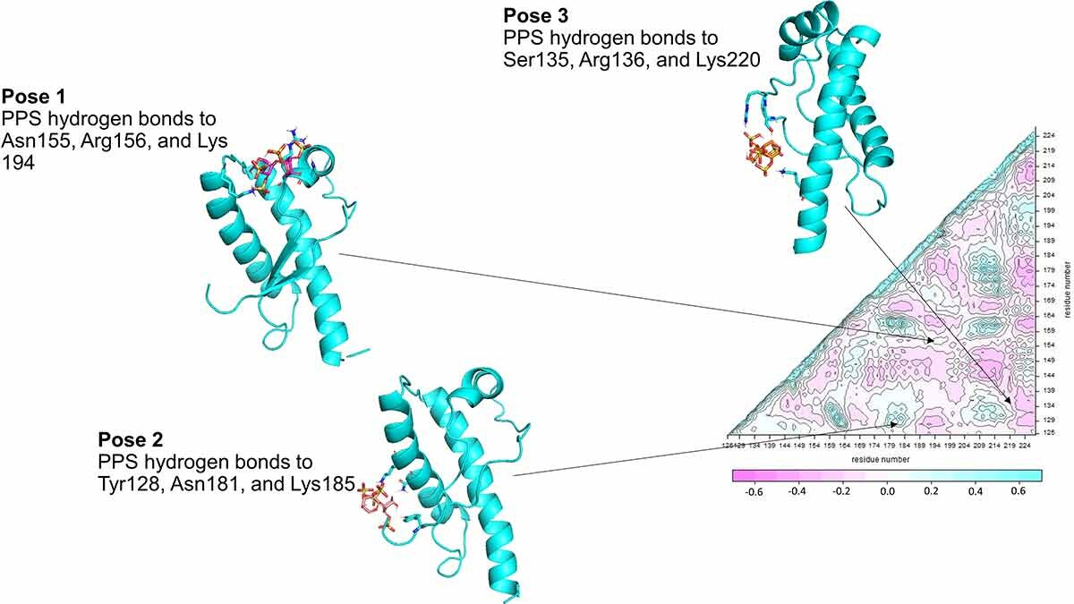
Pharmacological Chaperones Assist in Protein Folding
Soto, P., Gloeb, G. M., Tsuchida, K. A., Charles, A. A., Greenwood, N. M., & Hendrickson, H. (2023). Insight into the conserved structural dynamics of the C-terminus of mammal PrPC identifies structural core and possible structural role of pharmacological chaperones. Prion, 17(1), 55-66.
Notes:
Previous work bound to sites on each of these subdomains to stabilize native conformation of prion protein
PPS acts as pharmacological chaperone when bound to each subdomain, helping protein to fold into native conformation

Slide 10
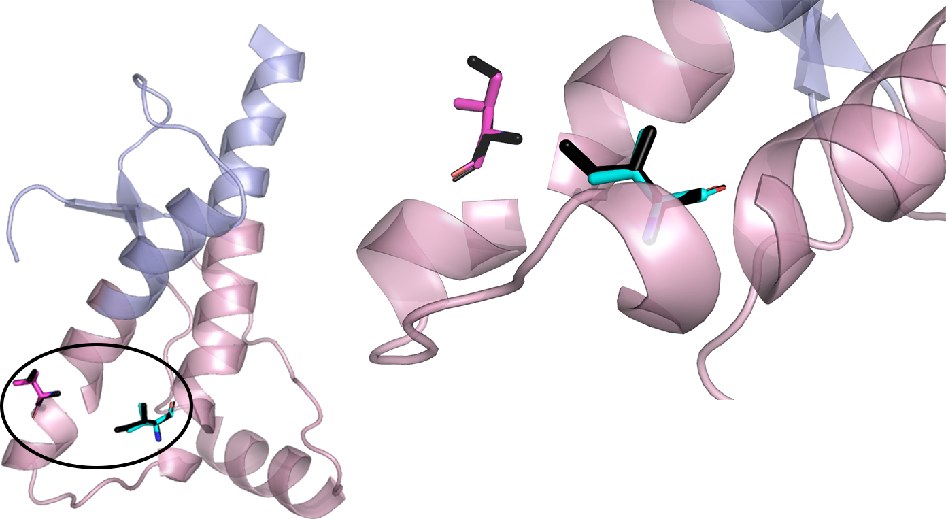
V189I and V203I Identified as Mutations of Interest
Notes:
First step: find a mutation or mutations that destabilize the protein structure
Not all infectious mutations to PRNP destabilize native conformation, but valine-isoleucine at 189 or 203 do

Slide 11
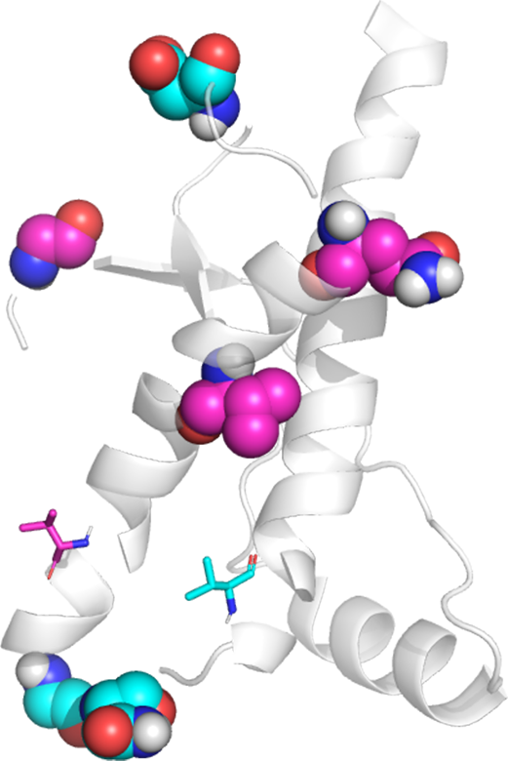
Markov Transient Analysis Reveals Potential Regulatory Sites
Residue 189
Valine 180
Glycine 127
Glutamine 172
Residue 203
Asparagine 197
Glycine 195
Aspartic Acid 167
Notes:
Next: find sites that are highly connected to mutation sites
Binding to these sites can do one of two things:
constraining effect on mutation site and/or misfold initiation site
induce flexibility at mutation and/or misfold initiation site

Slide 12
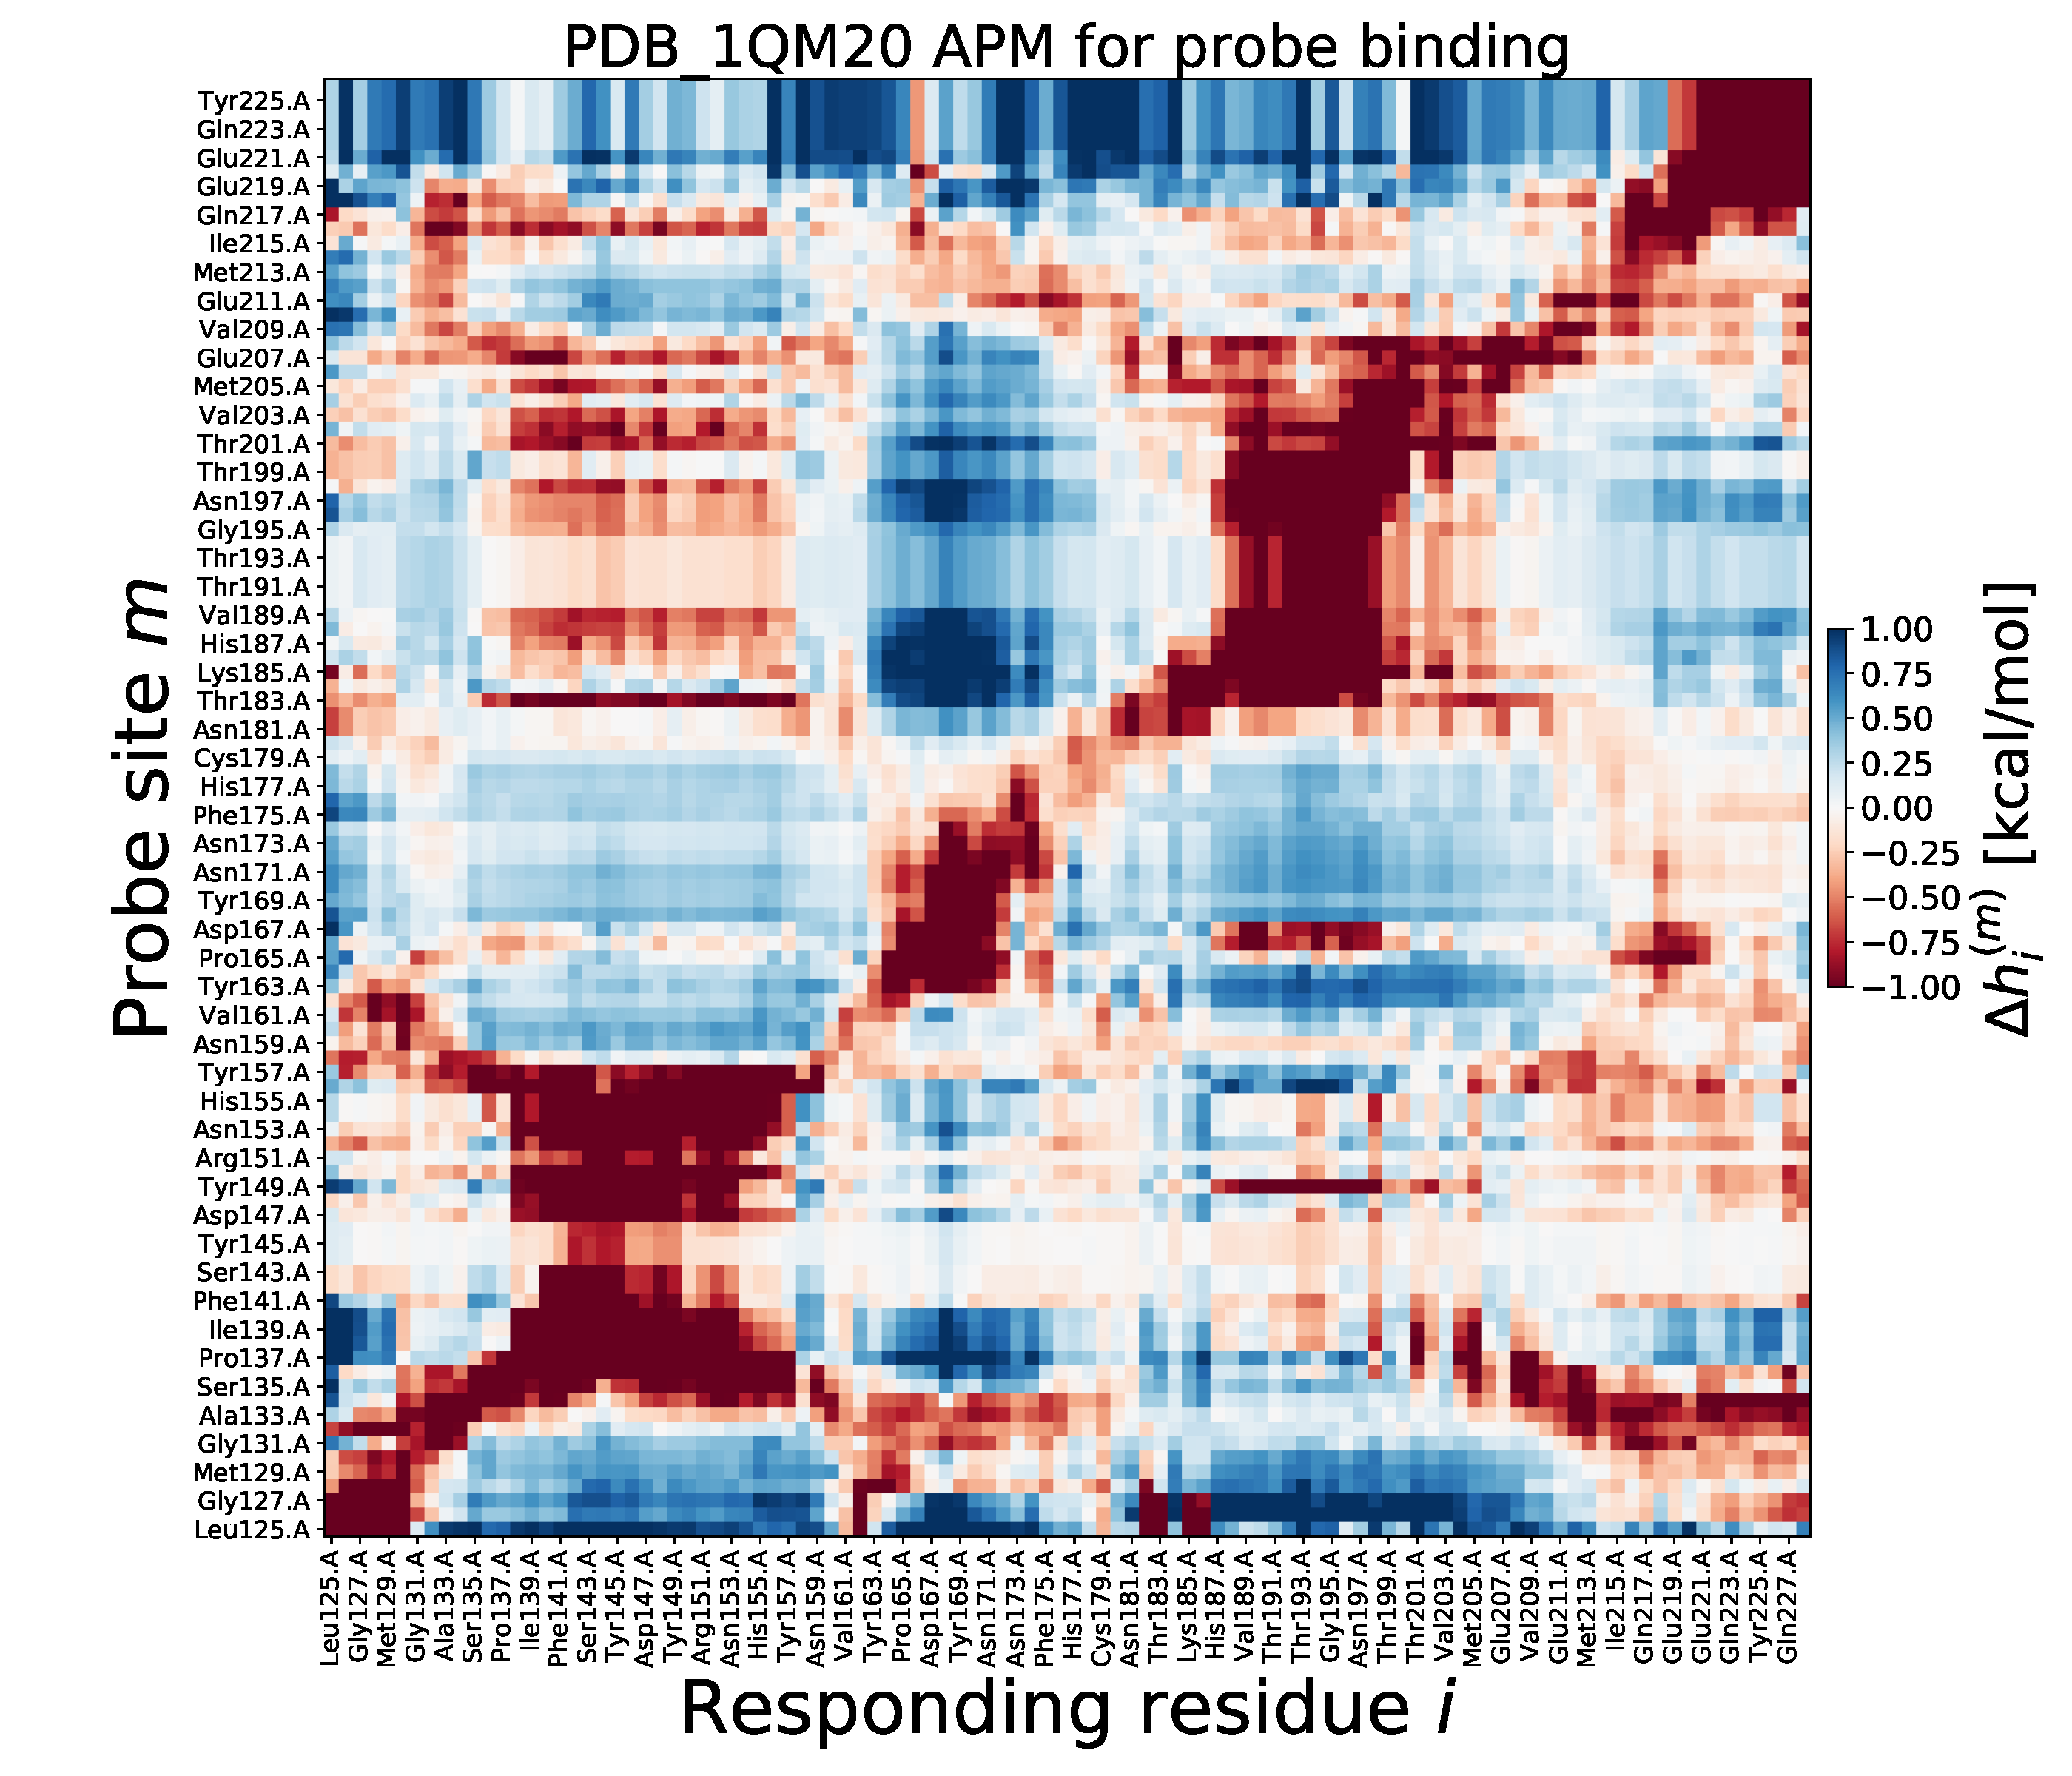
Proposed Binding Sites Identified Through Simulated Probe Binding
Notes:
Finally: test potential regulatory sites to find what sites add rigidity to misfold initiation site

Slide 13
Notes:
Binding to res 194-199 has constraining effect on res 194-199
So does binding to res 165-167
And binding to res 149

Slide 14
Proposed Binding Sites for Pharmacological Chaperones
Site A: Residues 166 and 167
Site B: Residues 149, 195, and 197
Notes:
From previous work, binding to a site on each subdomain may help protein fold to native conformation
I propose 2 binding sites that could be bound by drug molecule to prevent misfold:
Site A: res 166 and/or 167
Site B: res 149, 195, 197

Slide 15
Future Plans
Attempt to replicate results with other mammalian prion proteins
Identify molecules to test on binding sites through docking simulation
Build Machine-Learning algorithm to identify, test, and conclude best allosteric sites on proteins
Notes:
Attempt to replicate results with other mammalian prion proteins
Identify molecules to test on binding sites through docking simulation, then test
Build machine-learning algorithm to identify, test, and conclude best allosteric sites on proteins

Slide 16
Acknowledgements
Research and Academic Advisor
Dr. Joshua Ring
MIV-REU Personal Investigators and Peer Mentors
Dr. Jarrod French (The Hormel Institute, University of Minnesota)
Dr. Katherine Hicks (SUNY Cortland)
Dr. Andy Torelli (Ithaca College)
Olive Beyer and Sarah Toay
Appalachian College Association
Ledford Scholars Program
Notes:
I would like to thank my research and academic advisor, Dr. Joshua Ring, for his continued guidance and support throughout this project. I would also like to thank the personal investigators and peer mentors of the summer 2023 MIV-REU program for their expertise in the field of computational sciences and insight into the current techniques used for docking analysis. Finally, I would like to thank the Appalachian College Association and their Ledford Scholars Program for funding this first stage of my research.

Slide 17



Questions?
Reagan McNeill Womack
reagan.womack@my.lr.edu
reagan.romack@outlook.com
Scan for GitHub Repository!
Notes:
Thank you, are there any questions?

